Slide 1



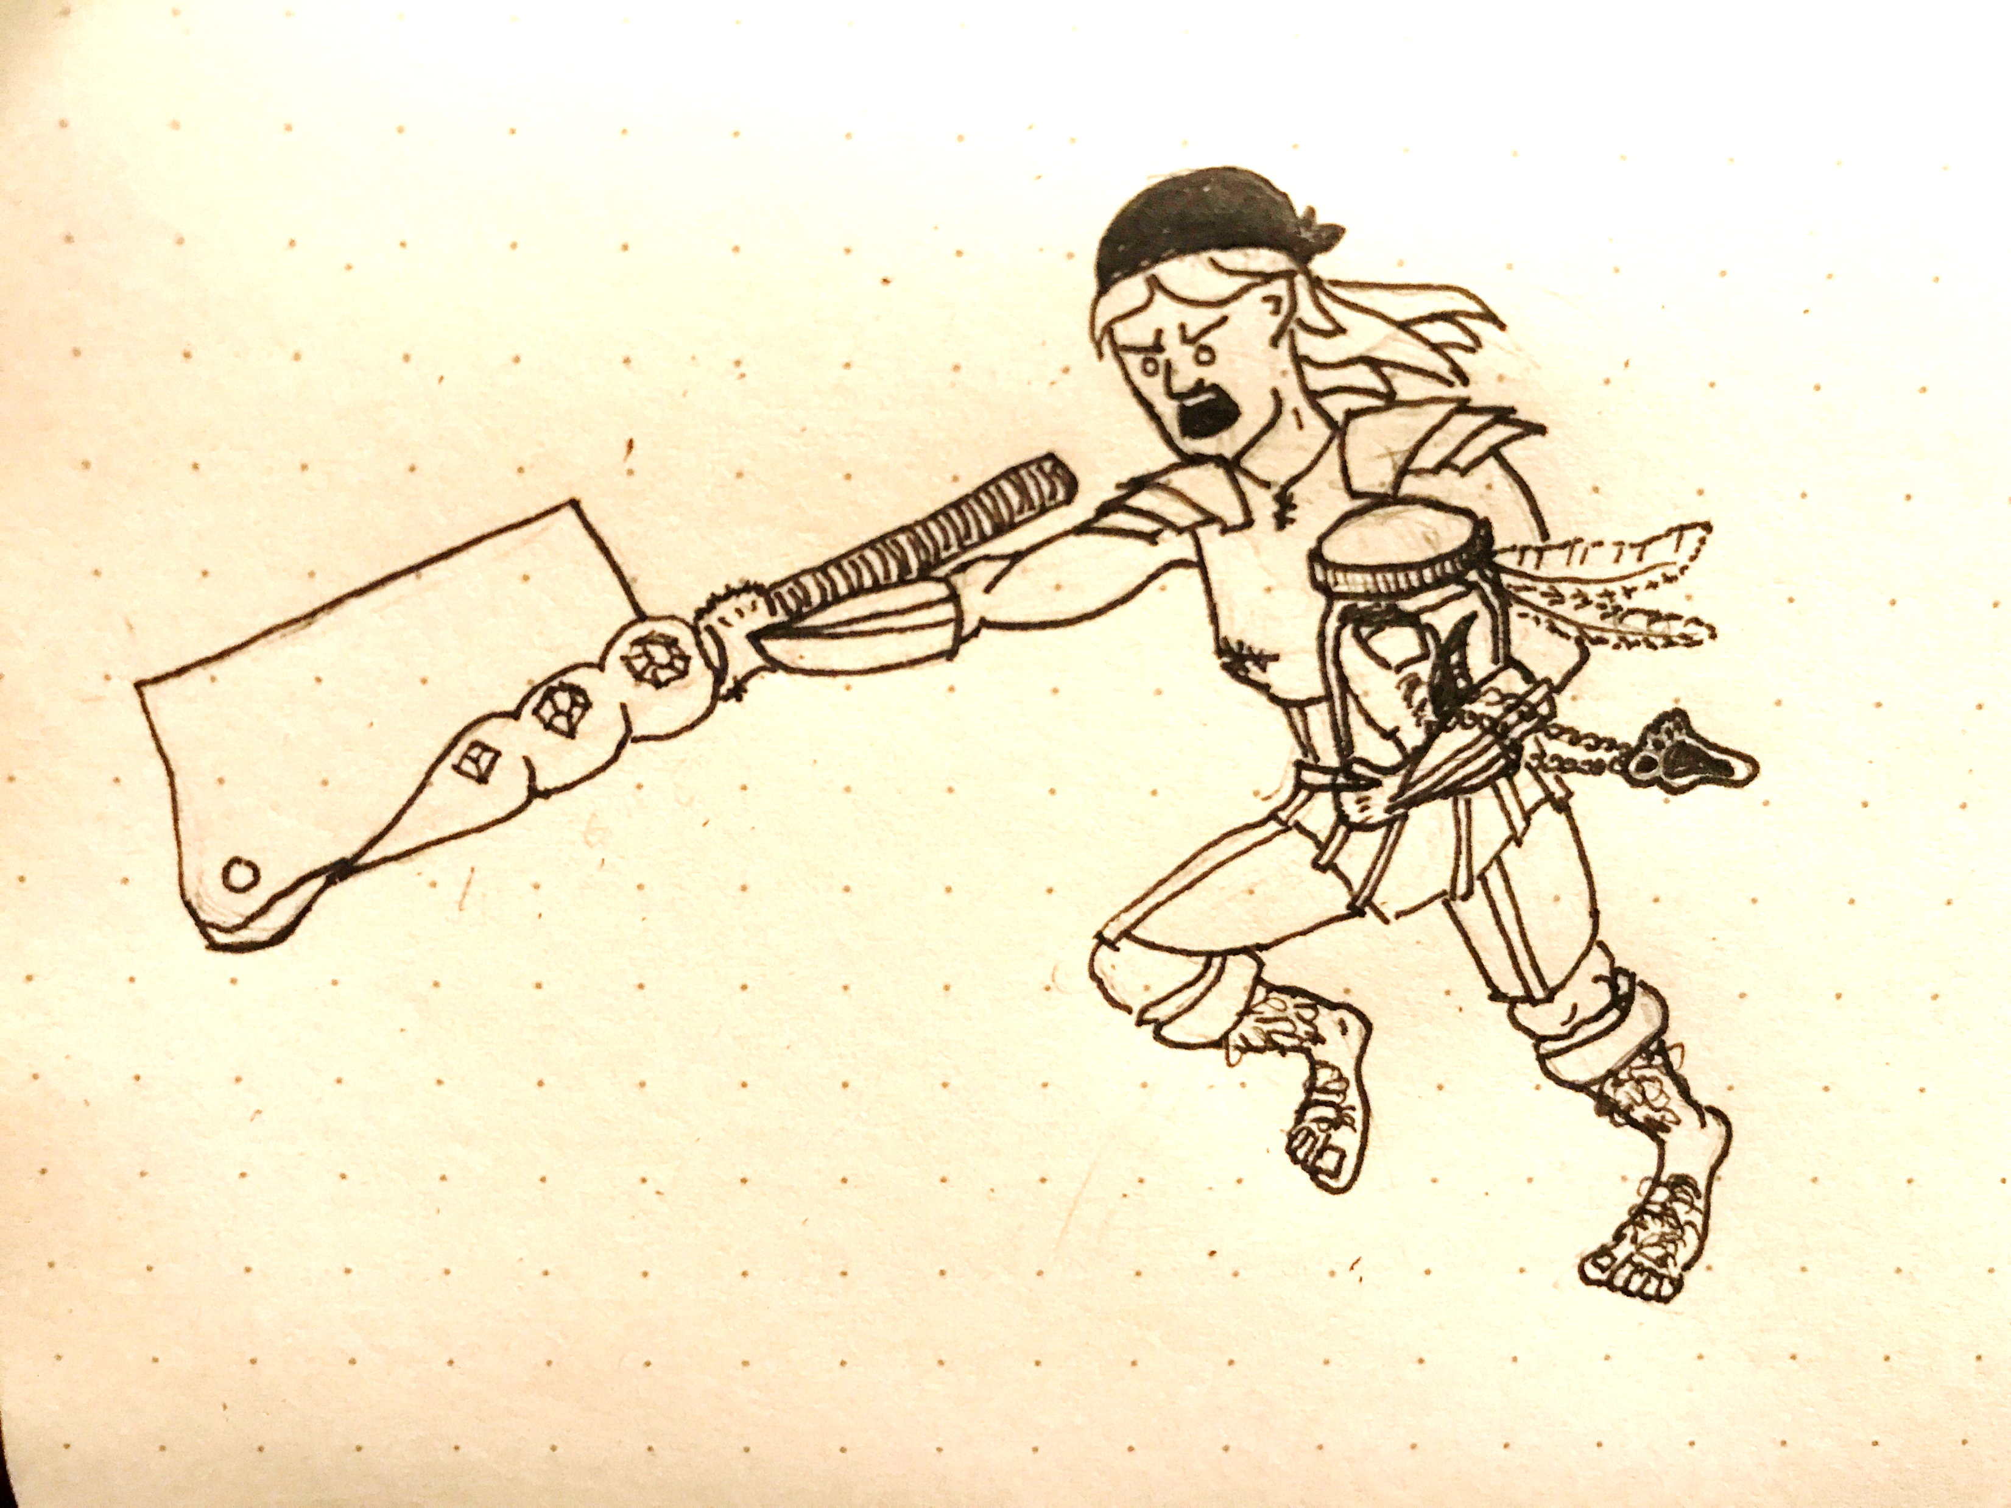

Szilárd Gyalay
Current research: geophysics of icy satellites
Past research: ice on Mars, temperature of the Moon

